Slide 1
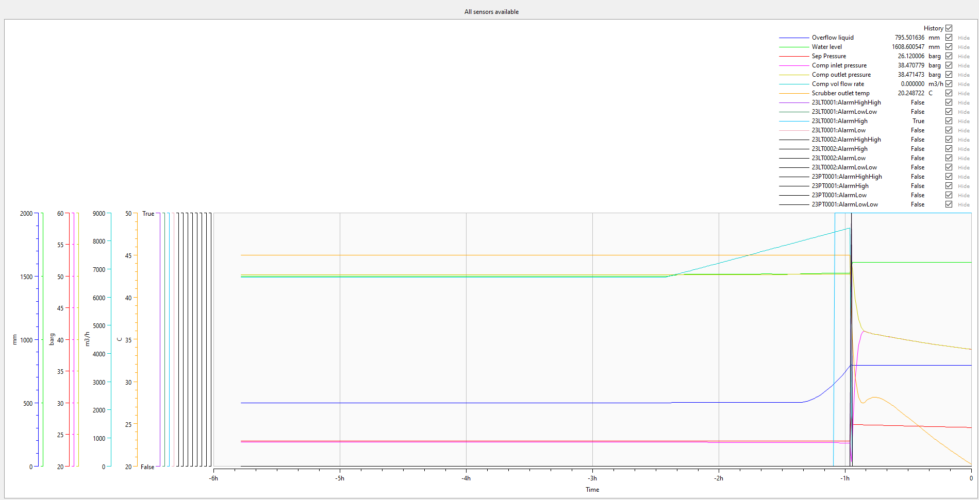
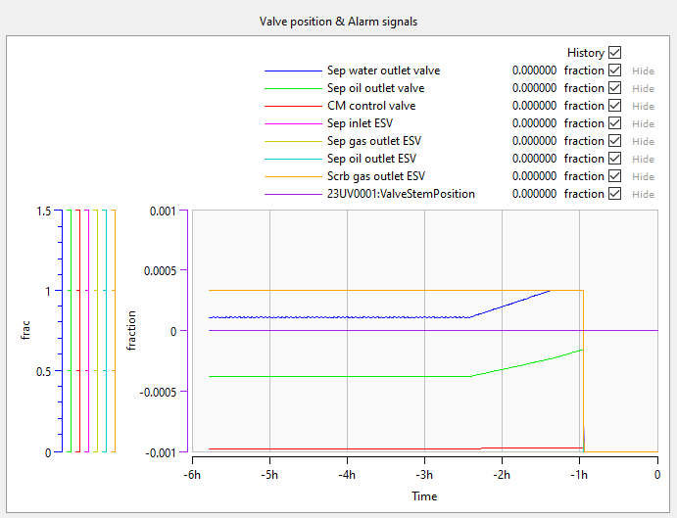
Training scenario
The system was under normal operation (for 200 mins) with small production fluctuation but faced an abnormal increase from wellhead side.

Slide 2
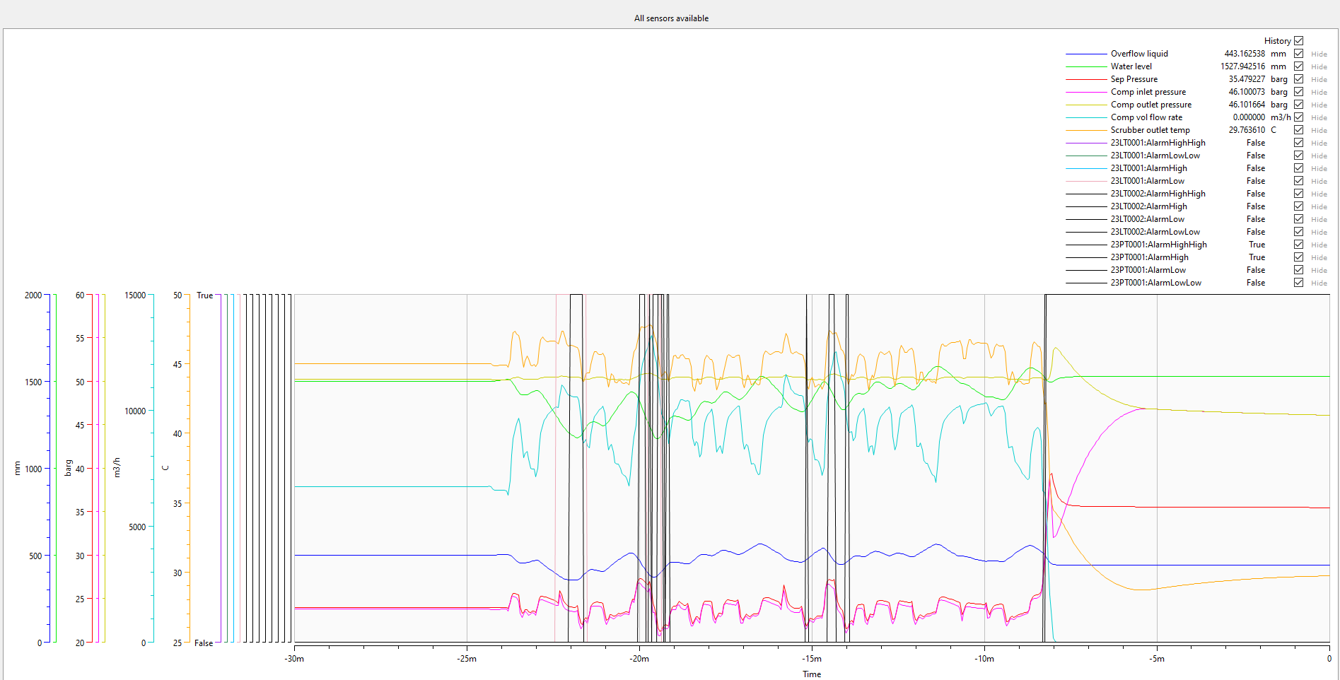
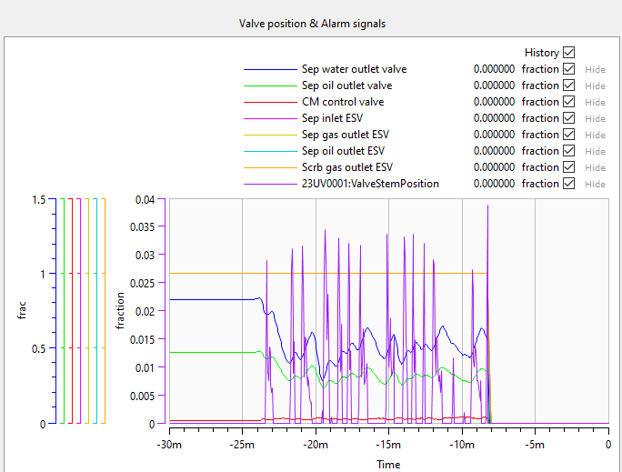
Test scenario
The system was able to manage continuous sluggish flow, but it gave too much stress on the compressor. Compressor is broken/damaged after few minutes, so polytropic efficiency is deteriorated by 70% in 10 mins.

Slide 3
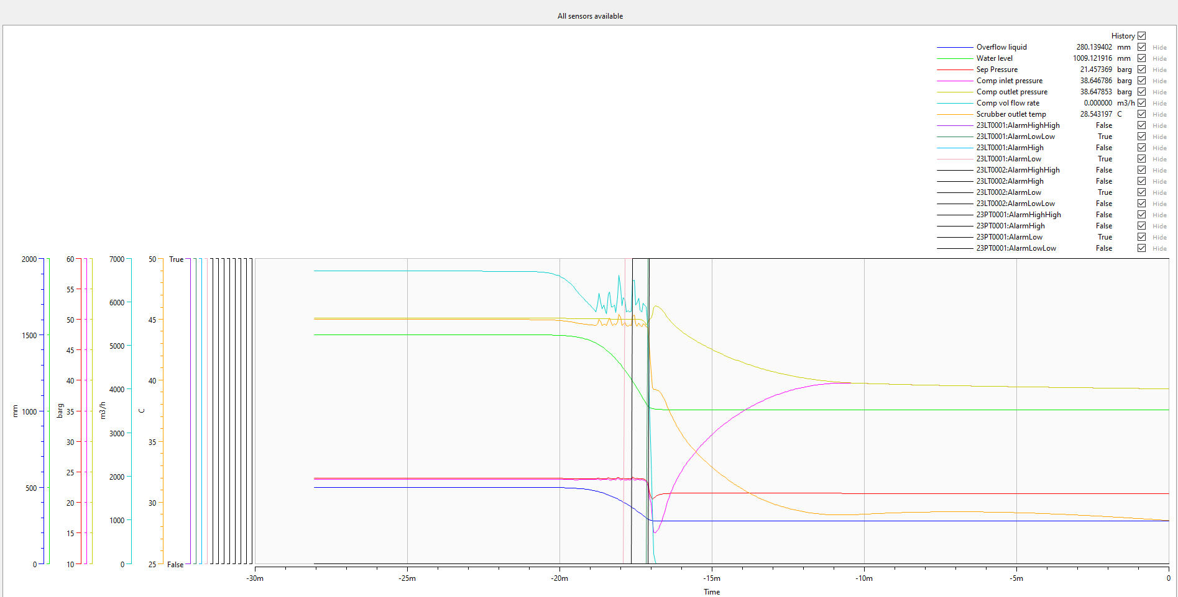
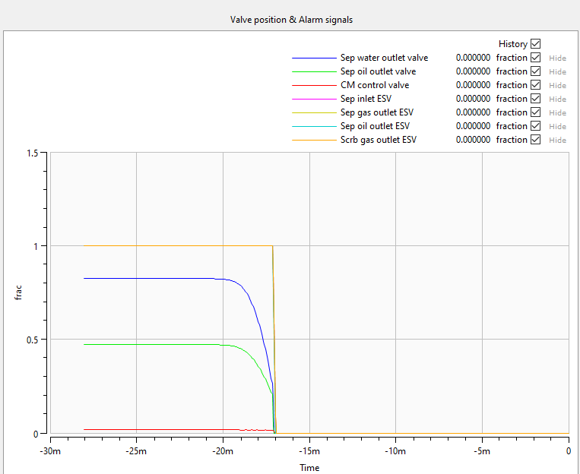
Maloperation scenario
1 – Sep inlet pipe plugging (0→100% in 10 mins)

Slide 4
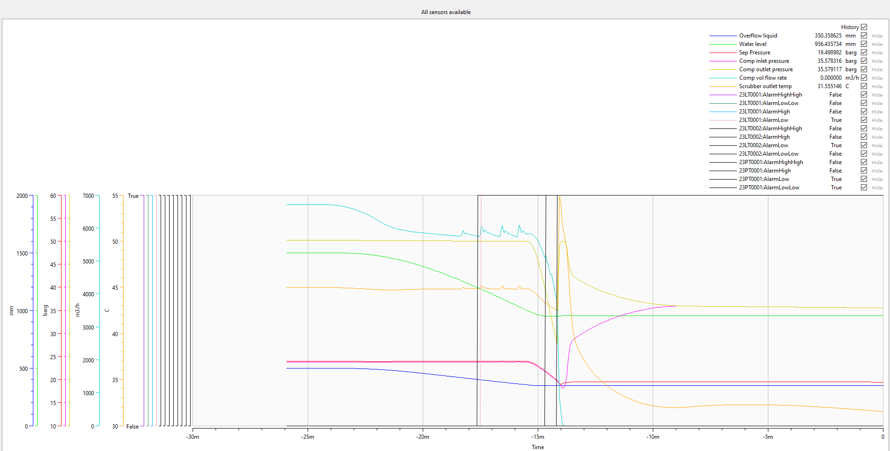
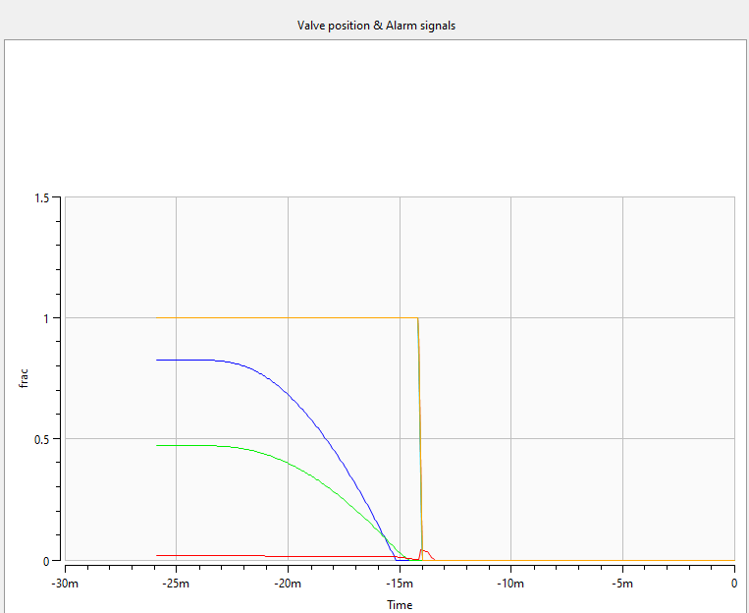
Maloperation scenario
2 – Sep inlet pipe leak (0→150/304.8mm in 10 mins)

Slide 5
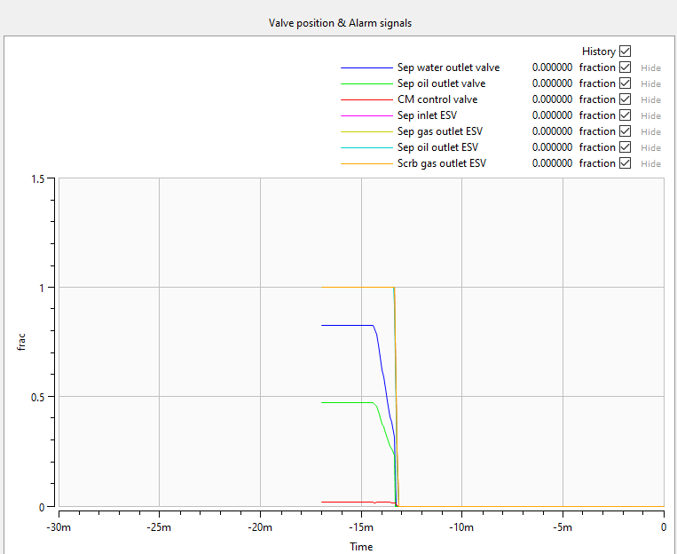
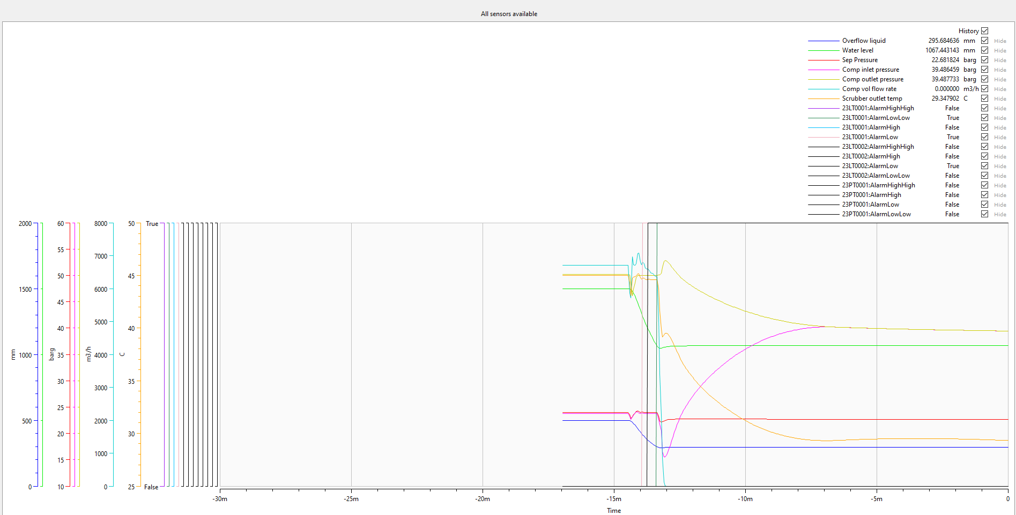
Maloperation scenario
3 – Sep inlet manual valve closed (0.5→0.1 at sudden)

Slide 6
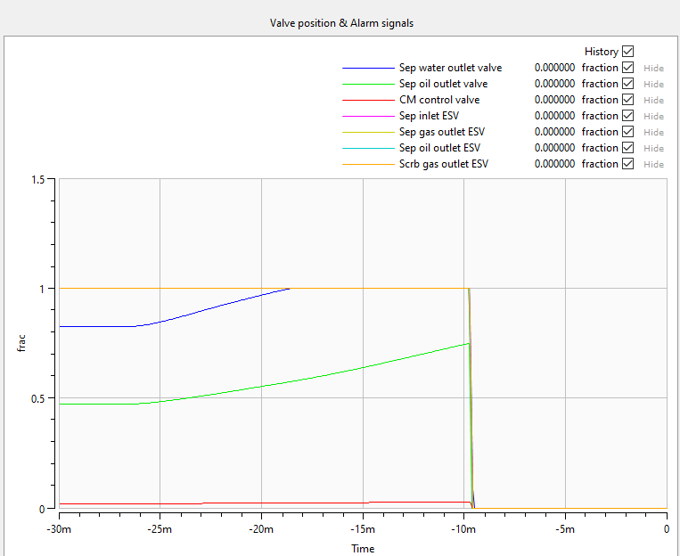
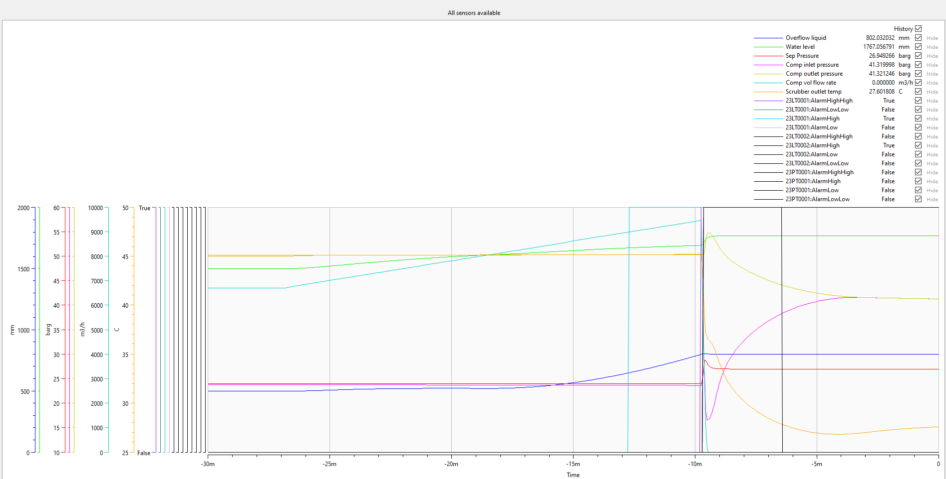
Maloperation scenario
4 – Malfunction on oil well operation (+) (55→79barg in 20 mins)

Slide 7
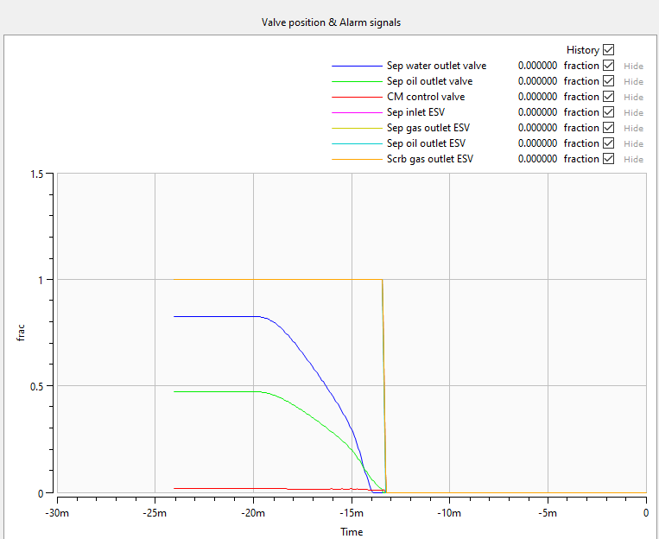
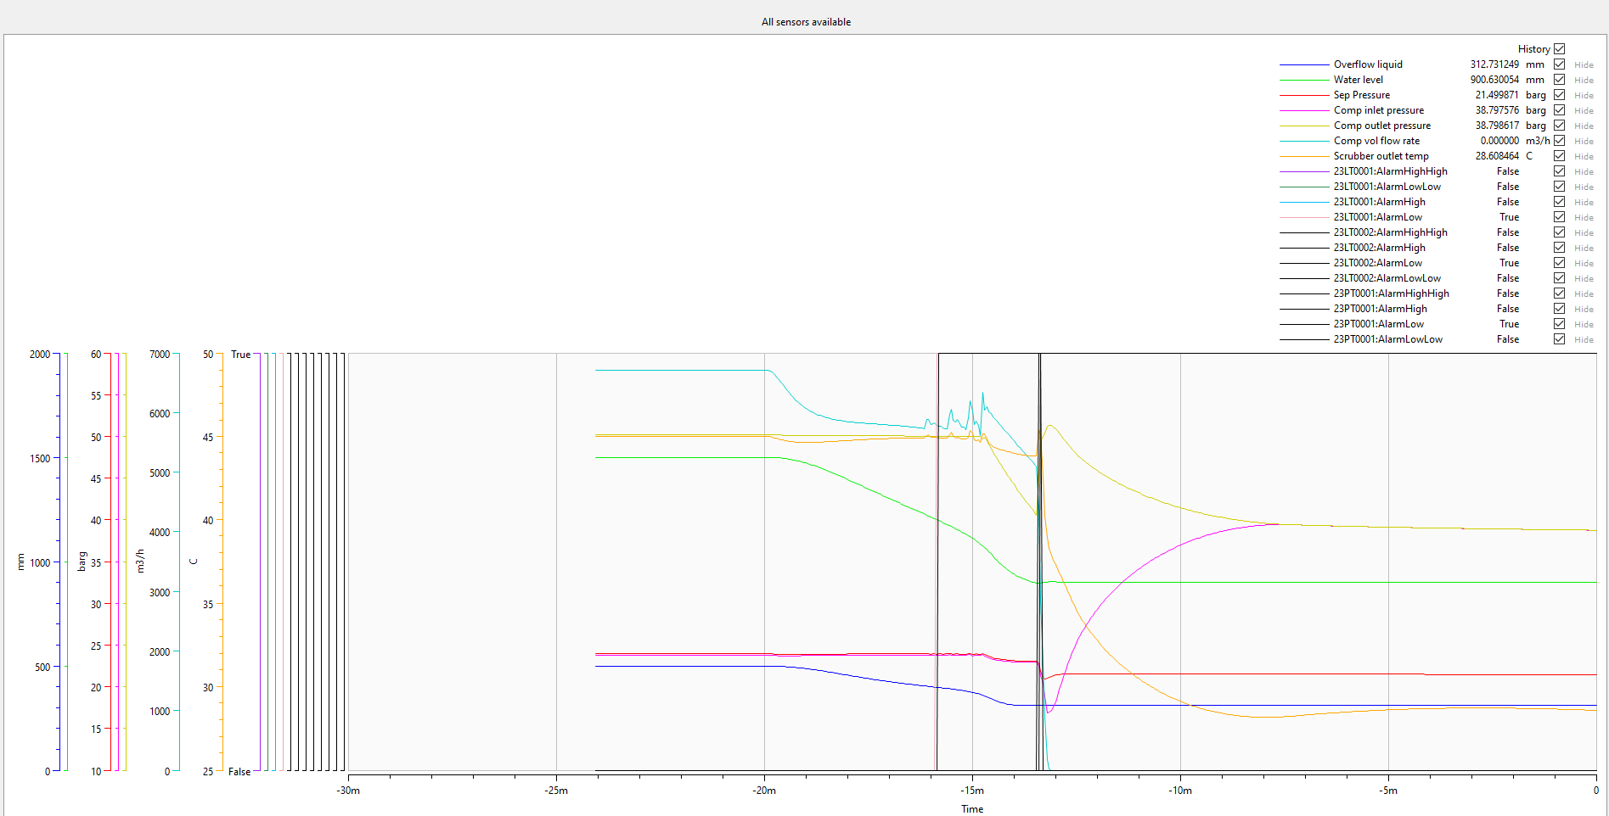
Maloperation scenario
5 – Malfunction on oil well operation (+) (55→19barg in 6 mins)

Slide 8
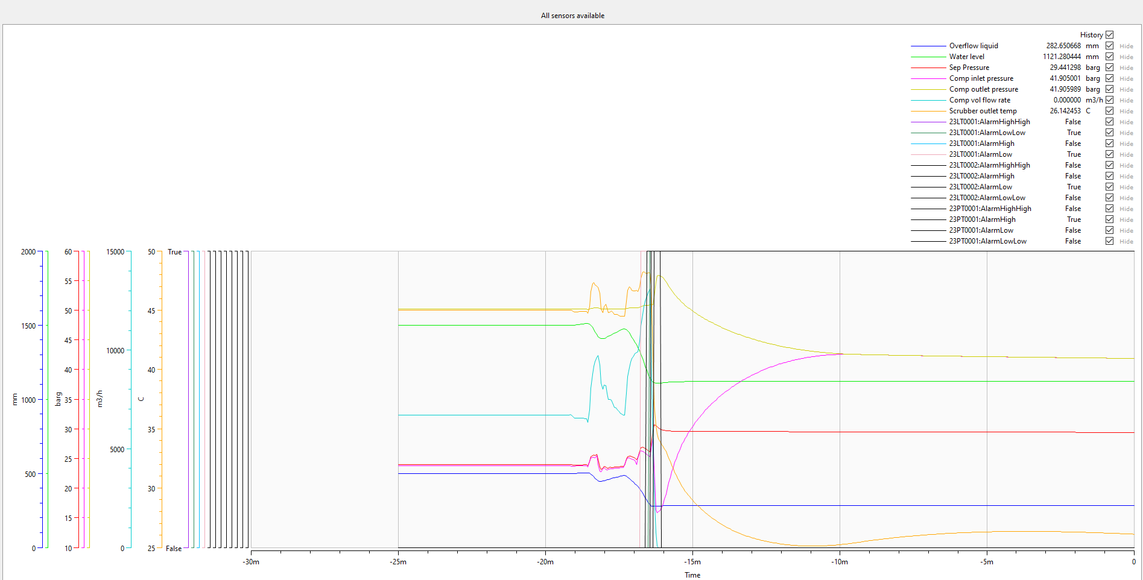

Maloperation scenario
6 – Sluggish flow from inlet stream

Slide 9
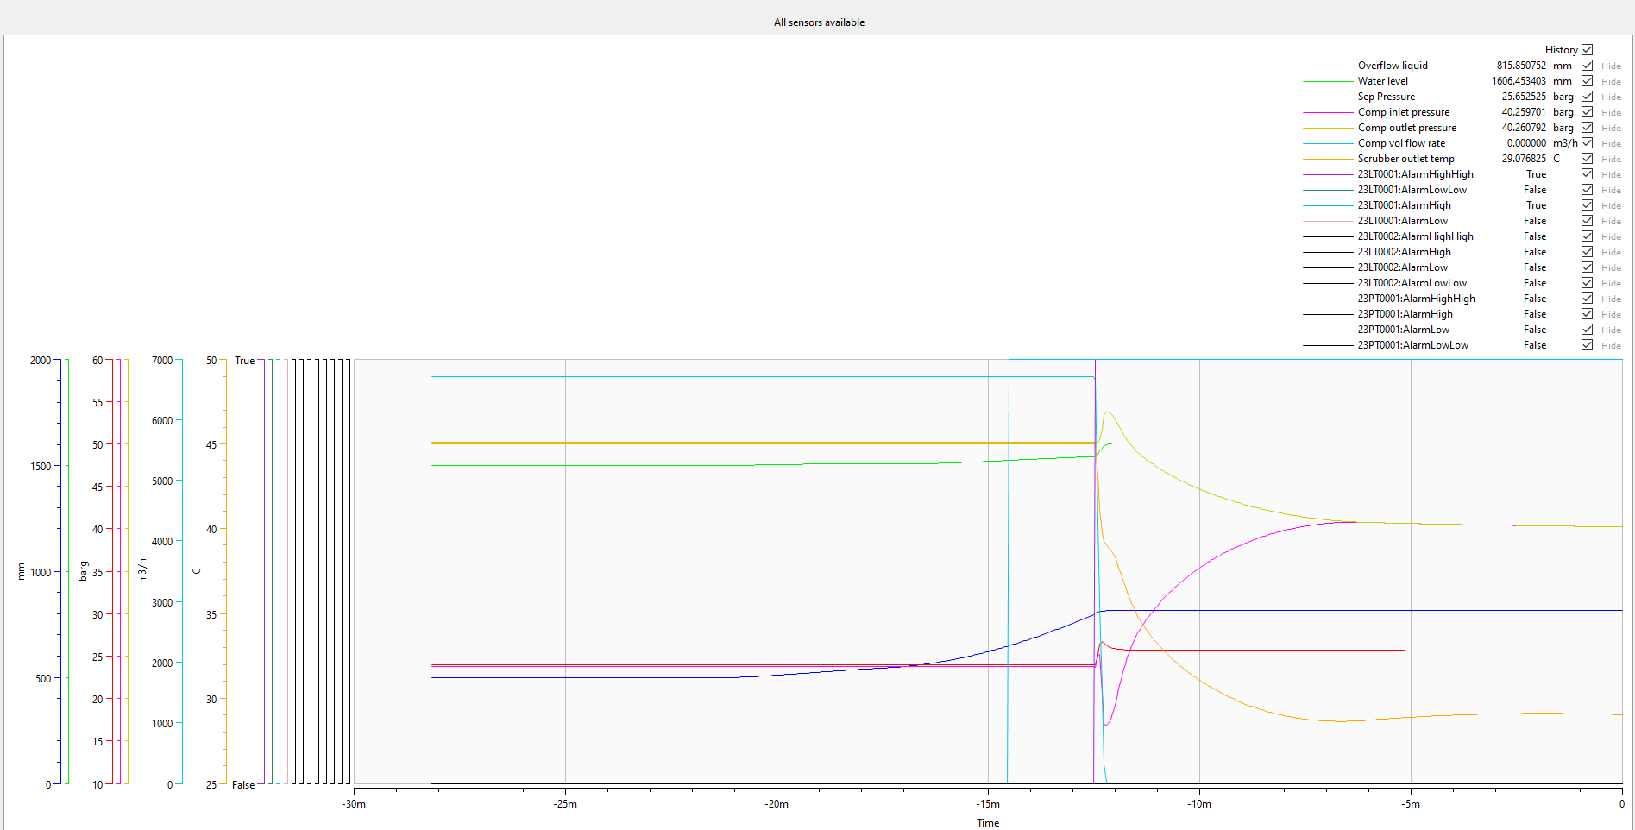
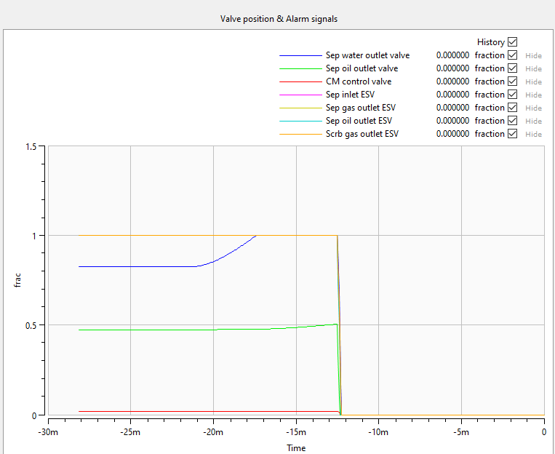
Maloperation scenario
7 – Sep water outlet plugging (0→50% in 10 mins)

Slide 10
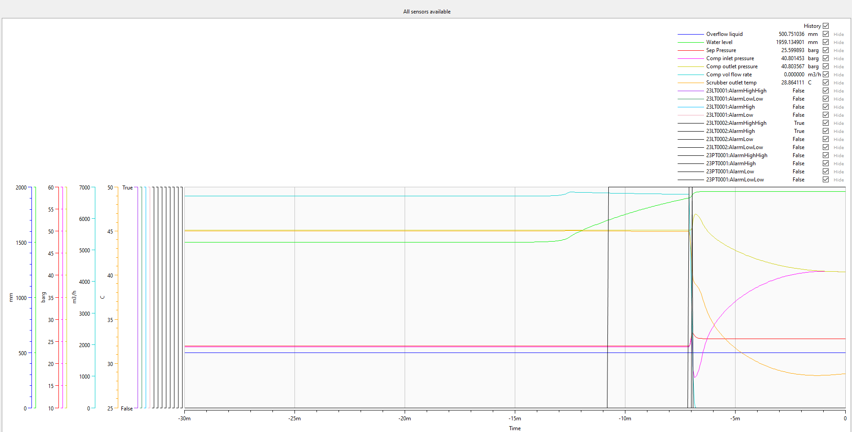
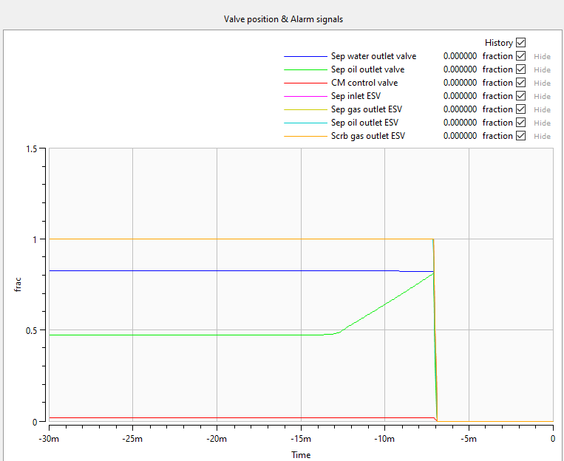
Maloperation scenario
8 – Sep oil outlet plugging (0→97% in 10 mins)

Slide 11
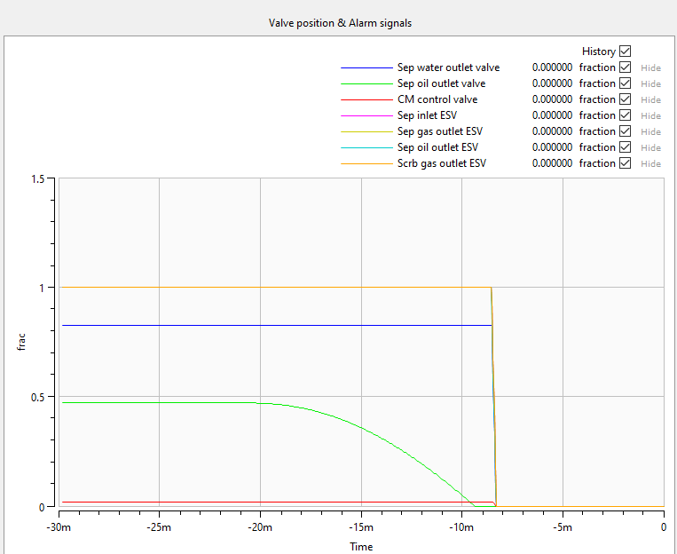
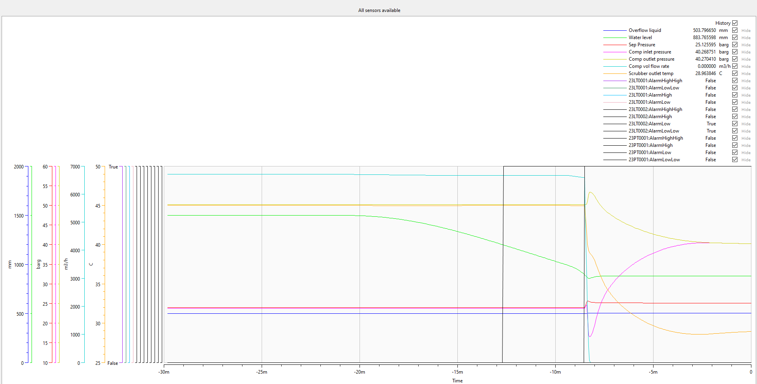
Maloperation scenario
9 – Sep oil outlet leakage (0→100mm in 20 mins)

Slide 12
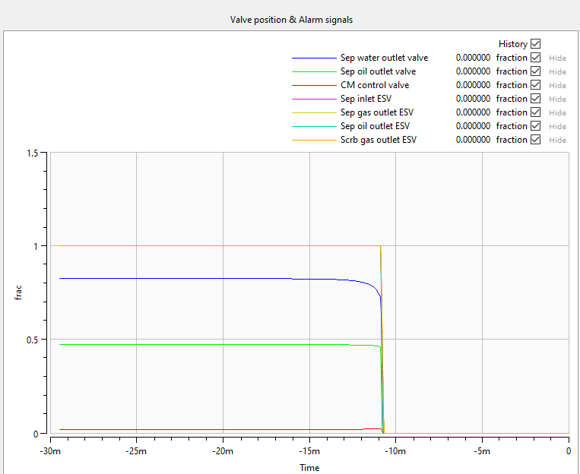
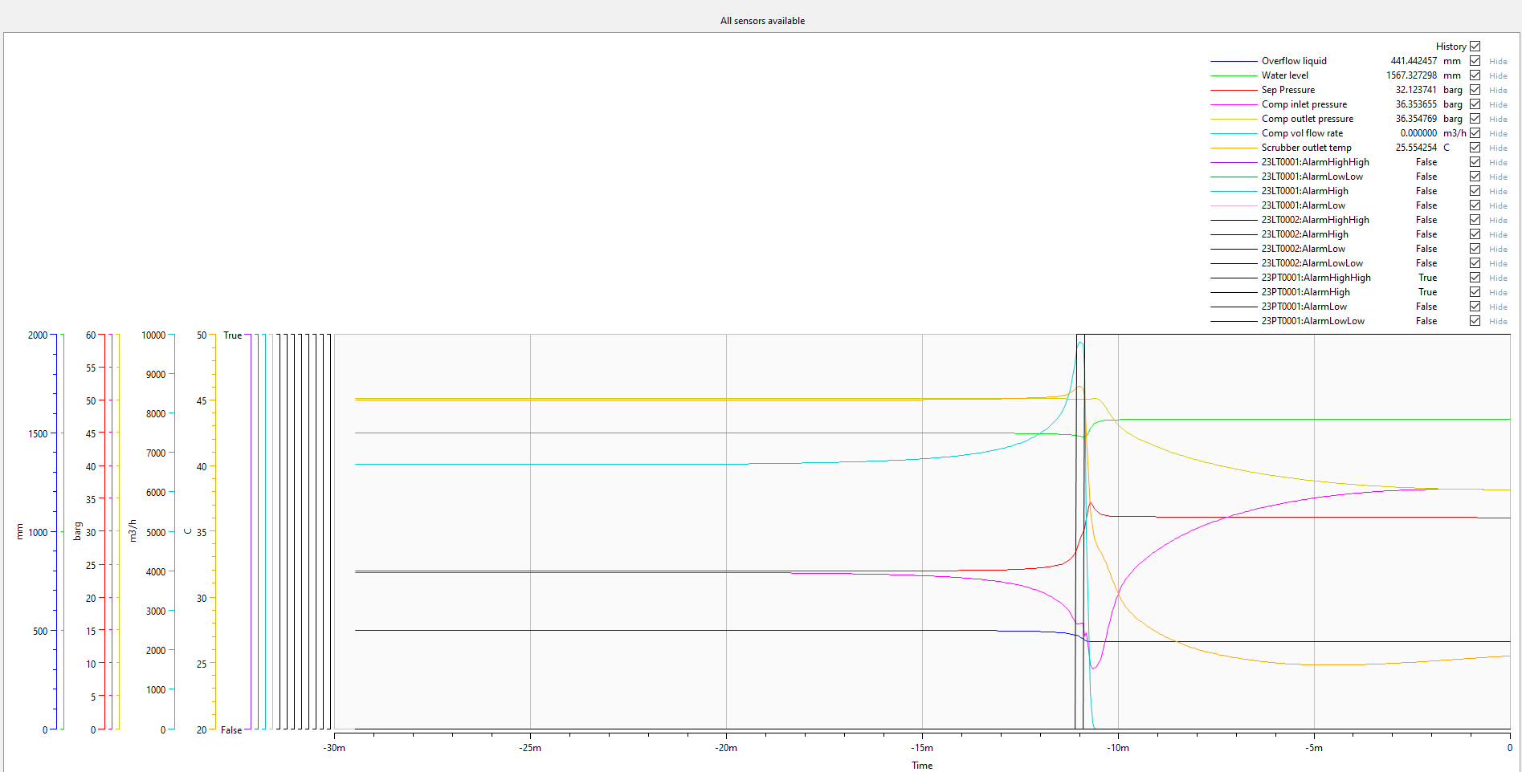
Maloperation scenario
10 – Sep gas outlet pipe plugging (0→90% in 10 mins)

Slide 13
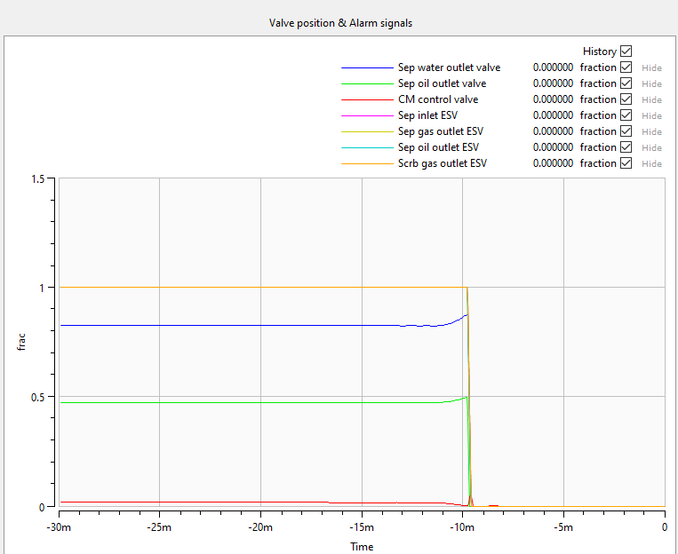
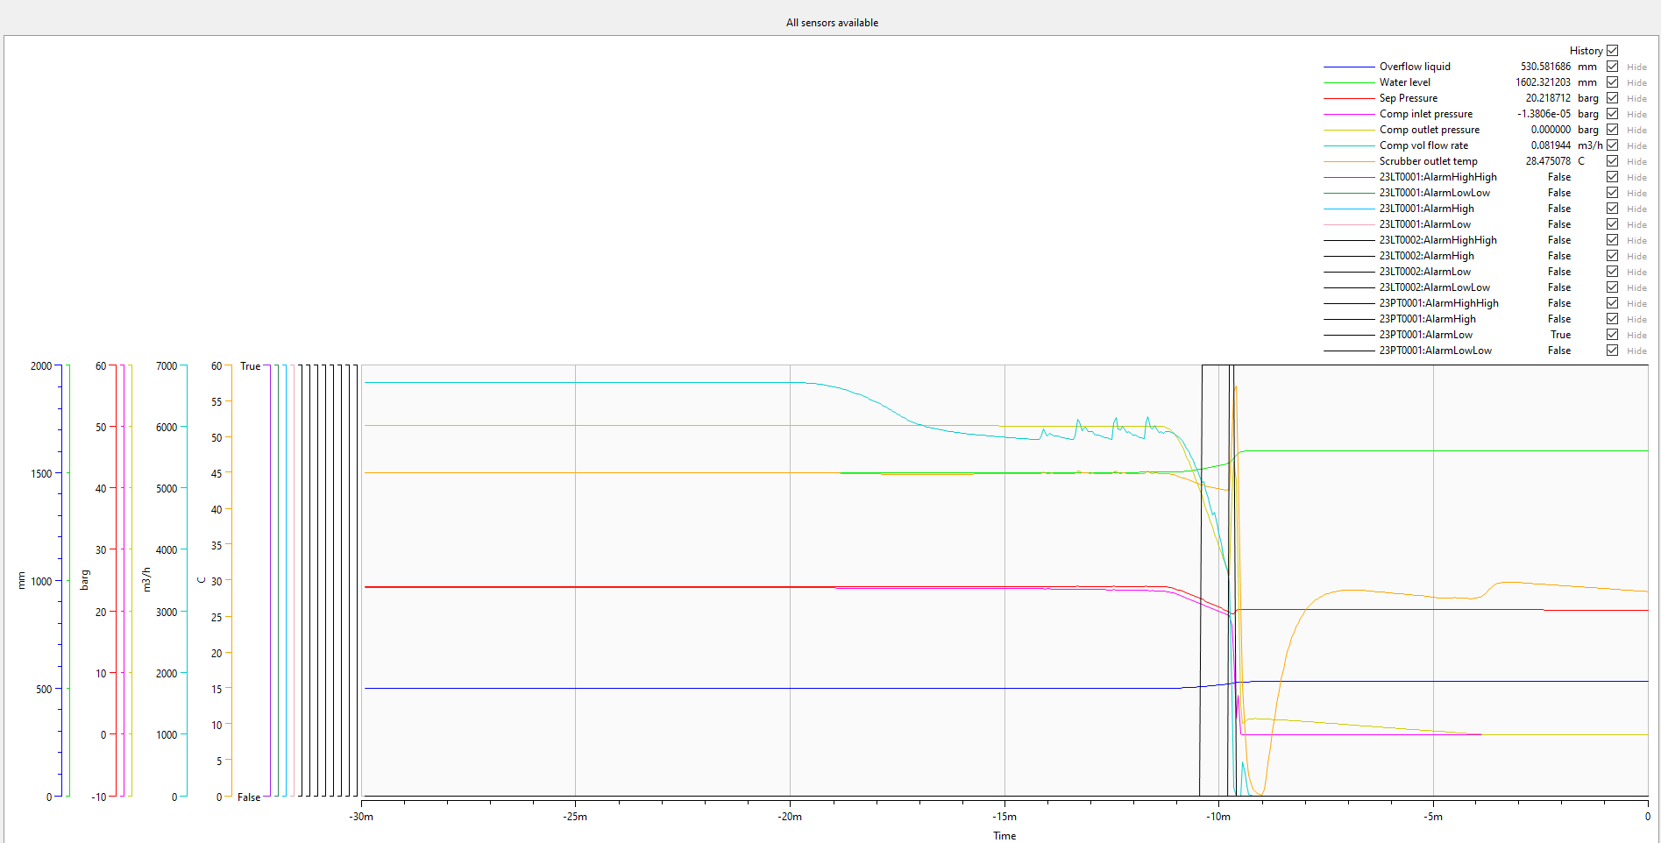
Maloperation scenario
11 – Sep gas outlet leakage (0→110mm in 10 mins)

